Slide 1


Franzisca Gorniacyzk
19.09.2022

Slide 2

Outline
Executive Summary
Introduction
Methodology
Results
Conclusion
Appendix

Slide 3
Outline
Executive Summary
Introduction
Methodology
Results
Conclusion
Appendix

Slide 4

Executive Summary
Topic
Evaluate SpaceX's success in launching their Falcon 9 rockets and then returning the booster unharmed, to be reused for further launches.
Approach
Gather data on previous Falcon 9 missions, analyze results and build predictive models.
Methodology
Gather data from remote sources/Internet, perform data wrangling, visualize using tables, graphs and maps, and use classification models to predict landing outcomes.
Results
Find how launch site, payload, booster version and Orbit type affect the landing outcome.
Conclusion
Classification models have an 80% accuracy in prediction the success of future landing attempts.

Slide 5
Outline
Executive Summary
Introduction
Methodology
Results
Conclusion
Appendix

Slide 6
Introduction
SpaceX:
American aerospace company building rockets to transport cargo and humans (payload) into orbits around earth or to other planetoids (moons and planets)
Falcon 9 rocket:
SpaceX's partially reusable rocket type, consisting of booster (responsible for lift-off) and second stage (responsible for carrying payload to final destination).
Booster:
Falcon 9's booster have the ability to land again after separating from the second stage. They can be reused for further launches. This results in a significant reduction of expenses.
Question:
Which parameters are essential for a successful landing of the Falcon 9 boosters and can we predict the outcomes of future landing attempts?

Slide 7
Outline
Executive Summary
Introduction
Methodology
Results
Conclusion
Appendix

Slide 8
Outline
Executive Summary
Introduction
Methodology
Results
Conclusion
Appendix
Data collection
Data wrangling
Exploratory data analysis (EDA)
Interactive visual analytics
Predictive analysis

Slide 9
Outline
Executive Summary
Introduction
Methodology
Results
Conclusion
Appendix
Data collection
Data wrangling
Exploratory data analysis (EDA)
Interactive visual analytics
Predictive analysis

Slide 10
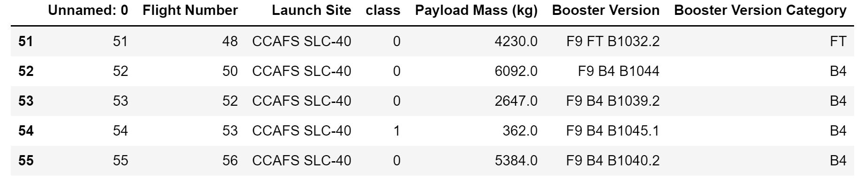
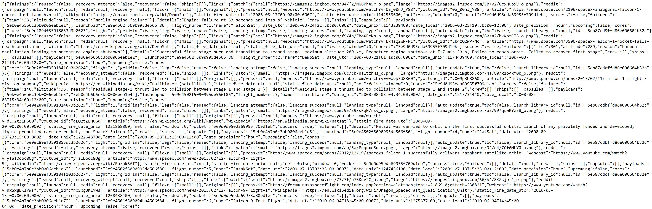
Github:
https://github.com/franziscaG/Coursera_Capstone_Project/blob/master/jupyter-labs-spacex-data-collection-api.ipynb
Data Collection – SpaceX API
Client
(Local Program)
Python:
Request
Response (data)
import requests
import pandas as pd
# request data from API
url = "name_of_REST_API"
response = requests.get(url)
# convert JSON to pandas dataframe
df = pd.json_normalize(response)
REST API
( https://api.spacexdata.com/v4/... )
Remote server
(SpaceX launch data)

Slide 11
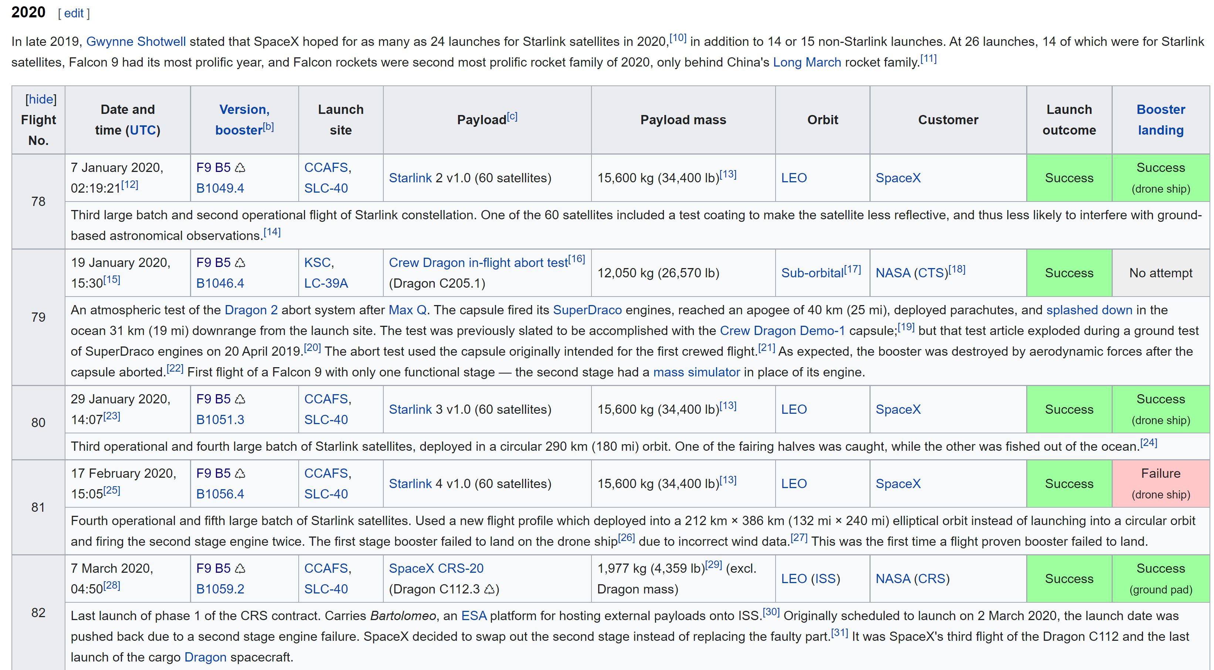
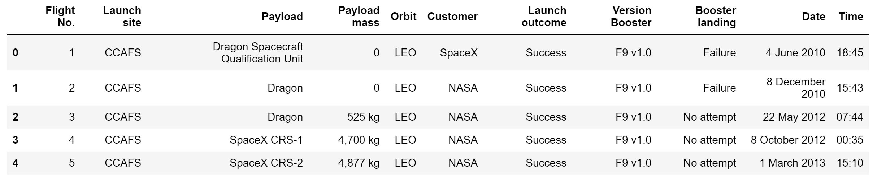
Github:
https://github.com/franziscaG/Coursera_Capstone_Project/blob/master/jupyter-labs-spacex-data-wrangling.ipynb
Data Collection – Web Scraping
Python:
Import data from website (wikipedia: List of Falcon 9 launches)
Parse html object for relevant data
Convert to readable dataframe
from bs4 import BeautifulSoup
# request data from API
url = "name_of_website"
response = requests.get(url)
# convert to BeautifulSoup object
soup = BeautifulSoup(response.text)
# find tables
html_tables = Soup.find_all('table')
# iterate through table elements and add to new pandas dataframe
df = ...

Slide 12
Outline
Executive Summary
Introduction
Methodology
Results
Conclusion
Appendix
Data collection
Data wrangling
Exploratory data analysis (EDA)
Interactive visual analytics
Predictive analysis

Slide 13
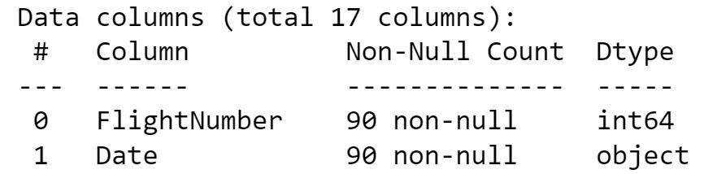
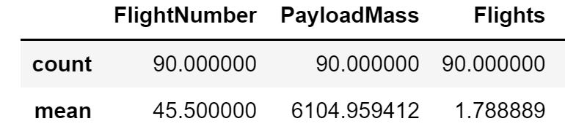
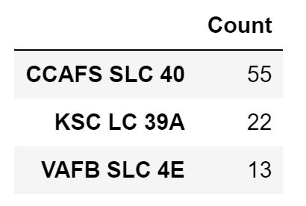
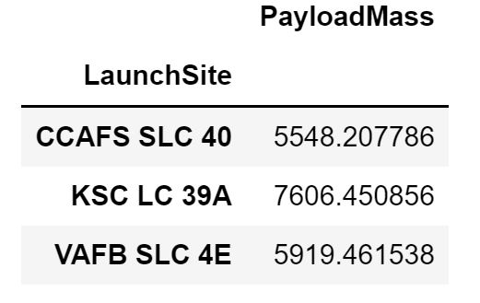
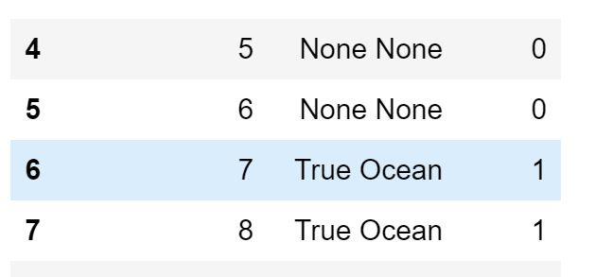
Github:
https://github.com/franziscaG/Coursera_Capstone_Project/blob/master/jupyter-labs-spacex-data-wrangling.ipynb
Data Wrangling
Data type and information
Data statistics
Data grouping
df.info()
df.describe()
df['column'].value_counts()
df.groupby('column').mean()
# classify outcome into good (1) and bad (0) into column 'class'
Target variable CLASS

Slide 14
Outline
Executive Summary
Introduction
Methodology
Results
Conclusion
Appendix
Data collection
Data wrangling
Exploratory data analysis (EDA)
Interactive visual analytics
Predictive analysis

Slide 15
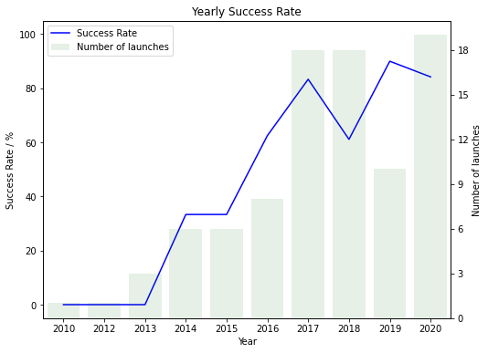
Github:
https://github.com/franziscaG/Coursera_Capstone_Project/blob/master/jupyter-labs-eda-dataviz.ipynb
EDA with Data Visualization
import seaborn as sns
Scatter plots: CLASS vs Payload mass, Flight number, Launch Site and Orbit
Answers which variable affects the landing outcome
Bar plot: Success rate vs Orbit
Shows which orbit leads to the most successful landings
Line plot: Success rate vs Year
Shows the improvements over the years
sns.catplot(x='FlightNumber',y='LaunchSite',data=df,hue='Class')
sns.catplot(x='Orbit',y='SuccessRate',data=bar_df,kind='bar')
sns.lineplot(x='Year',y='SuccessRate',data=line_df)

Slide 16
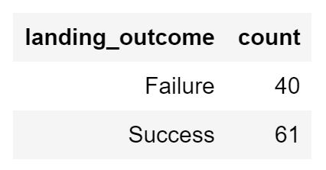
Github:
https://github.com/franziscaG/Coursera_Capstone_Project/blob/master/jupyter-labs-eda-sql-coursera_sqllite.ipynb
EDA with SQL
import sqlite3
# create local database and load data into it
connection = sqlite3.connect('database_name')
df = read.csv('data_repository')
df.to_sql('SPACEXTBL',connection)
# sql magic
%load_ext sql
%sql lite:///database_name.db
Ex. Find number of successful landings
%%sql
SELECT
CASE
WHEN [Landing _Outcome] LIKE '%Success%' THEN 'Success'
ELSE 'Failure'
END AS landing_outcome,
COUNT(Date) AS count
FROM SPACEXTBL GROUP BY landing_outcome

Slide 17
Outline
Executive Summary
Introduction
Methodology
Results
Conclusion
Appendix
Data collection
Data wrangling
Exploratory data analysis (EDA)
Interactive visual analytics
Predictive analysis

Slide 18
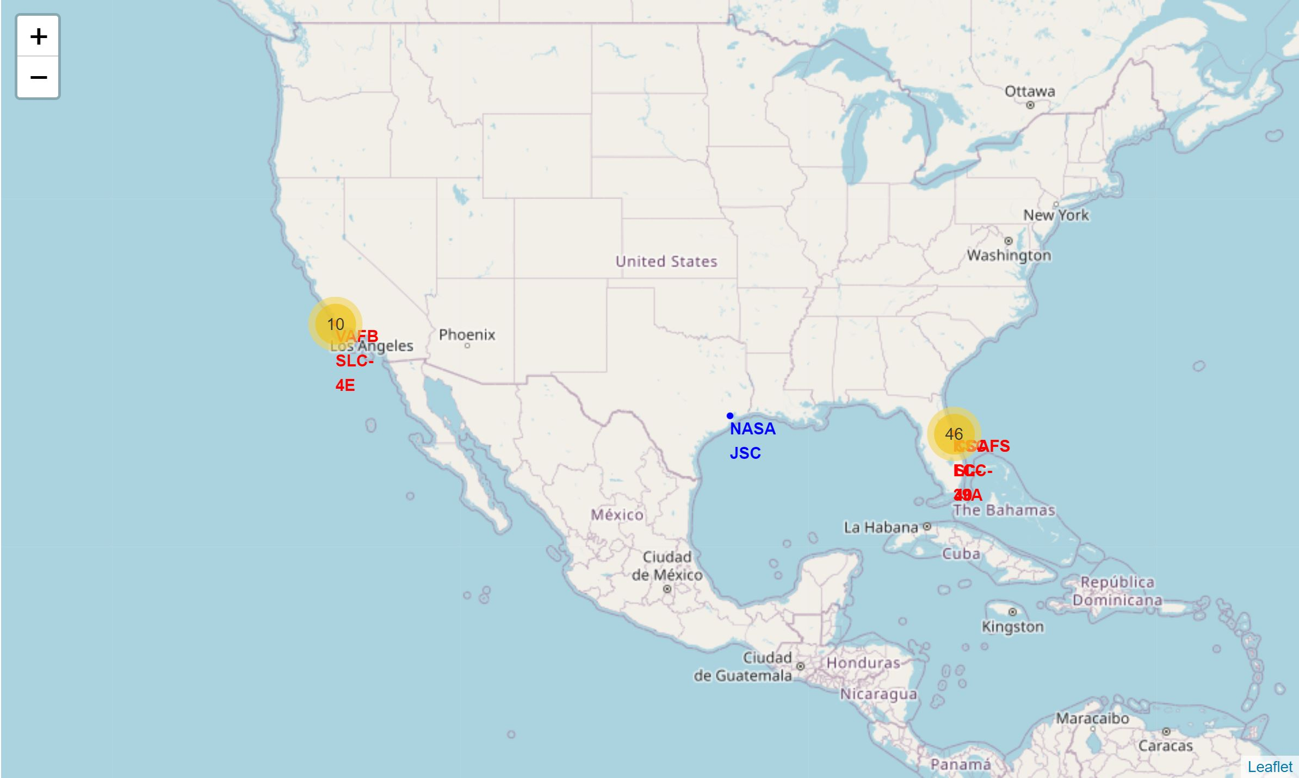
Github:
https://github.com/franziscaG/Coursera_Capstone_Project/blob/master/lab_jupyter_launch_site_location.ipynb
Build an Interactive Map with Folium
import folium
from folium.plugins import MarkerCluster,MousePosition
from folium.features import DivIcon
site_map = folium.Map(location, zoom_start)
Circles and markers: to mark launch sites
Marker-cluster: to mark launches (green – successful landing, red – failure)
Lines and markers: to mark closest coast, railway, highway and city
circle = folium.Circle(coordinates).add_child(folium.Popup(label))
marker=folium.Marker(coordinates, icon)
line=folium.PolyLine(locations=[start,end])

Slide 19
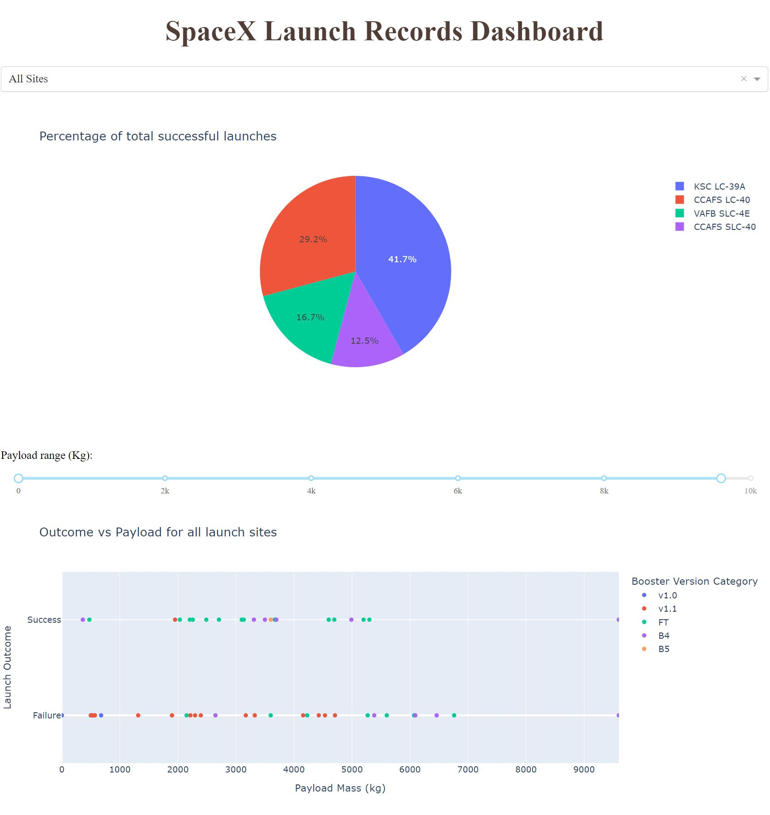
Github:
https://github.com/franziscaG/Coursera_Capstone_Project/blob/master/Dash_application.ipynb
Build a Dashboard with Plotly Dash
Dropdown menu: to choose Launch Site
Pie chart:
to display the percentage of successful landings
Range Slider:
to choose a range of Payload Mass
Scatter Plot:
to display Landing Outcome vs Payload Mass
# refer to notebook on how to build a dash application in Python

Slide 20
Outline
Executive Summary
Introduction
Methodology
Results
Conclusion
Appendix
Data collection
Data wrangling
Exploratory data analysis (EDA)
Interactive visual analytics
Predictive analysis

Slide 21
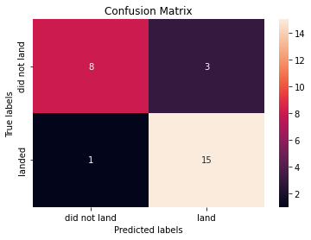
Github:
https://github.com/franziscaG/Coursera_Capstone_Project/blob/master/SpaceX_Machine%20Learning%20Prediction_Part_5.ipynb
Predictive Analysis (Classification)
Define target variable Y and dependent variables X
from sklearn import preprocessing
from sklearn.model_selection import train_test_split, GridSearchCV
transform = preprocessing.StandardScaler()
X = transform.fit_transform(X)
X_train,Y_train,X_test, Y_test = train_test_split(X,Y,test_size)
model=GridSearchCV(model_object,parameters, n_folds)
Normalize X
Split X and Y in training and testing sets
Split into n folds
Choose model parameters
Grid search on training set
Choose n-1 folds
Iterate over choice of n-1 folds and model parameters
Fit model
Best model parameters
Calculate accuracy for nth fold
Average over n-accuracies
Calculate accuracy on testing set
accuracy = model.fit(X_train,Y_train).score(X_test,Y_test)

Slide 22
Outline
Executive Summary
Introduction
Methodology
Results
Conclusion
Appendix

Slide 23
Outline
Executive Summary
Introduction
Methodology
Results
Conclusion
Appendix
Exploratory data analysis (EDA)
Interactive visual analytics
Predictive analysis

Slide 24
Outline
Executive Summary
Introduction
Methodology
Results
Conclusion
Appendix
Exploratory data analysis (EDA)
Interactive visual analytics
Predictive analysis

Slide 25
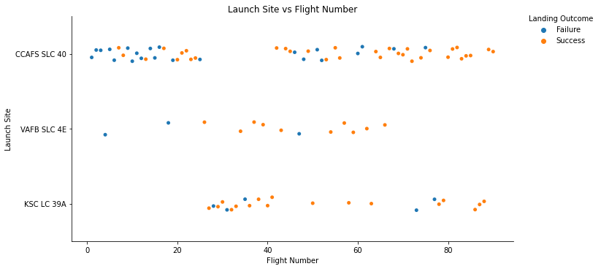
Flight Number vs. Launch Site
Earlier and most recent flights starting mostly from CCAFS SLC 40
No earlier flights from KSC LC 39A
No recent flights from VAFB SLC 4E
Increasing success rate with increasing Flight Number
Notes:
Show a scatter plot of Flight Number vs. Launch Site
Show the screenshot of the scatter plot with explanations

Slide 26
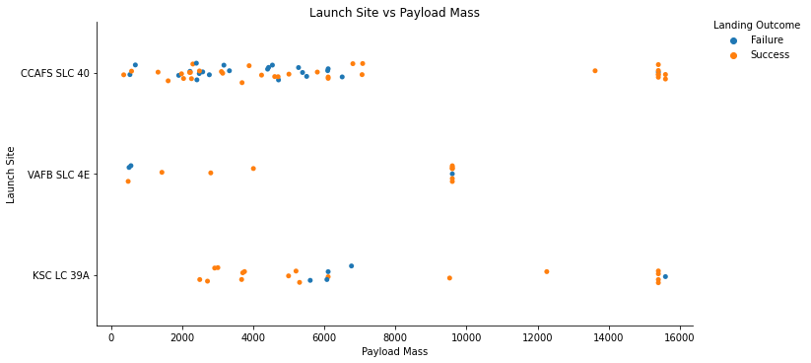
Payload vs. Launch Site
There are no heavy launches (mass>10000kg) from VAFB SLC 4E
High success rate for heavy launches from CAFS SLC 40 and KSC LC 39A
Notes:
Show a scatter plot of Payload vs. Launch Site
Show the screenshot of the scatter plot with explanations

Slide 27
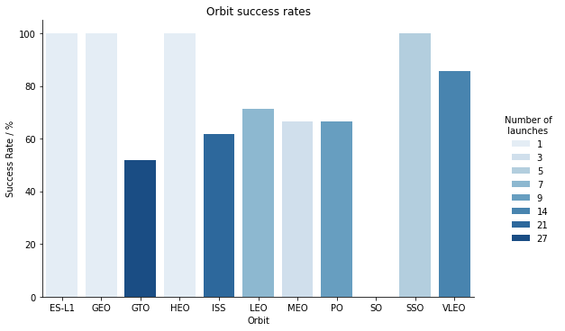
Success Rate vs. Orbit Type
High success rates for ES-L1, GEO, HEO and SSO orbits, but only few launches in these
Most launches into GTO orbit, but only about 50% success rate
Most promising orbit is VLEO with 14 launches and about 85% success rate
Notes:
Show a bar chart for the success rate of each orbit type
Show the screenshot of the scatter plot with explanations

Slide 28
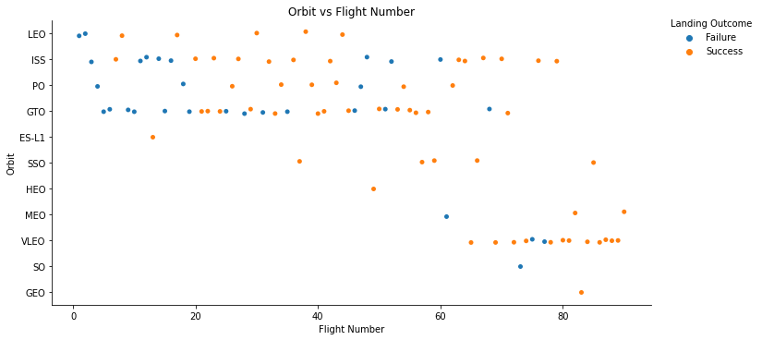
Flight Number vs. Orbit Type
Earlier flights mostly into LEO, ISS, PO and GTO orbits
Recent flights mostly into SSO, MEO, and VLEO orbits
Notes:
Show a scatter point of Flight number vs. Orbit type
Show the screenshot of the scatter plot with explanations

Slide 29
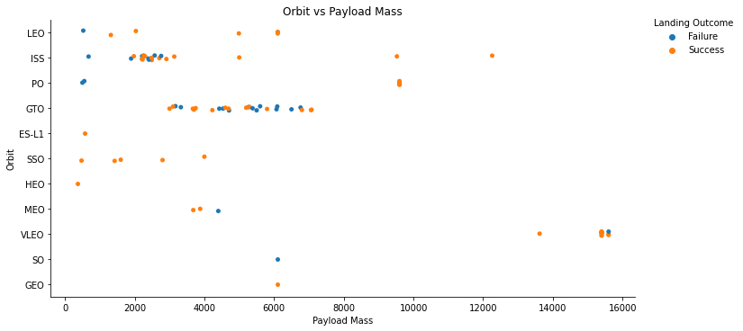
Payload vs. Orbit Type
Heavy launches (mass>10000kg) only into VLEO orbit
For LEO, ISS and PO heavier launches result in successful landings
Notes:
Show a scatter point of payload vs. orbit type
Show the screenshot of the scatter plot with explanations

Slide 30
Launch Success Yearly Trend
Non-monotonous increase in success rate between the years of 2013 to 2020
Notes:
Show a line chart of yearly average success rate
Show the screenshot of the scatter plot with explanations

Slide 31
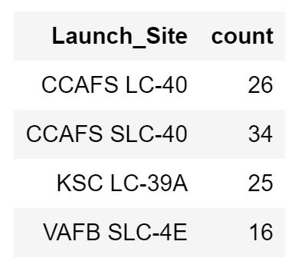
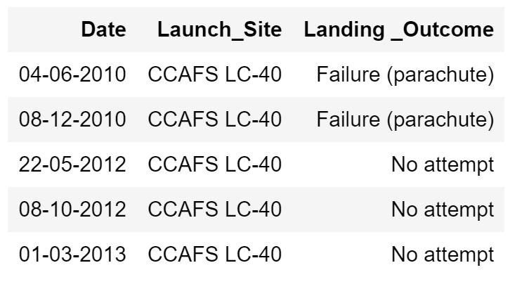
Launch Site Names
All unique launch sites
Five launches from CCAFS location
Notes:
Find the names of the unique launch sites
Present your query result with a short explanation here
Find 5 records where launch sites begin with `CCA`
Present your query result with a short explanation here

Slide 32
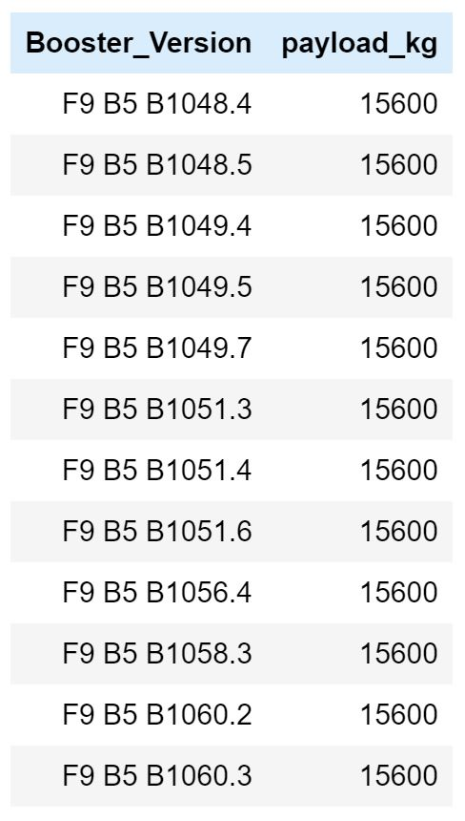
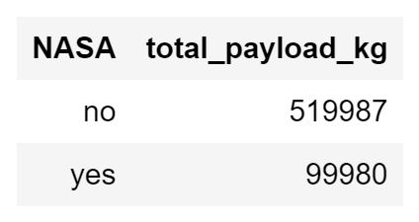
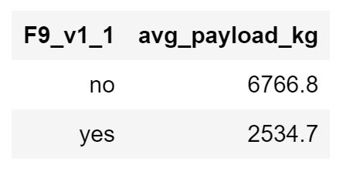
Payload Mass
Total payload carried by all the rockets launched for NASA
Average payload carried by the F9 v1.1 booster versions
Booster versions that carry maximum payload
Notes:
Calculate the total payload carried by boosters from NASA
Present your query result with a short explanation here
Calculate the average payload mass carried by booster version F9 v1.1
Present your query result with a short explanation here
List the names of the booster which have carried the maximum payload mass
Present your query result with a short explanation here

Slide 33
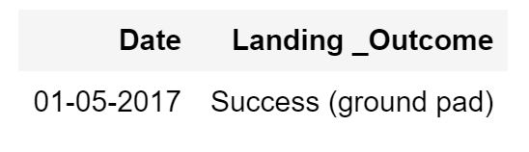
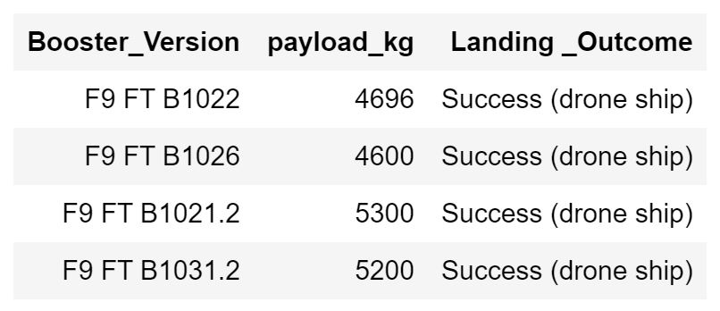
Successful Landings
Total number of successful and failed landings
First successful landing on a ground pad
Successful landings on a drone ship of rockets carrying a payload between 4000 and 6000 kg
Notes:
Find the dates of the first successful landing outcome on ground pad
Present your query result with a short explanation here
List the names of boosters which have successfully landed on drone ship and had payload mass greater than 4000 but less than 6000
Present your query result with a short explanation here
Calculate the total number of successful and failure mission outcomes
Present your query result with a short explanation here

Slide 34
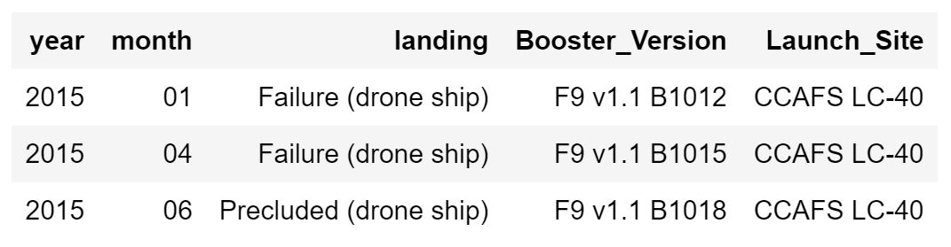
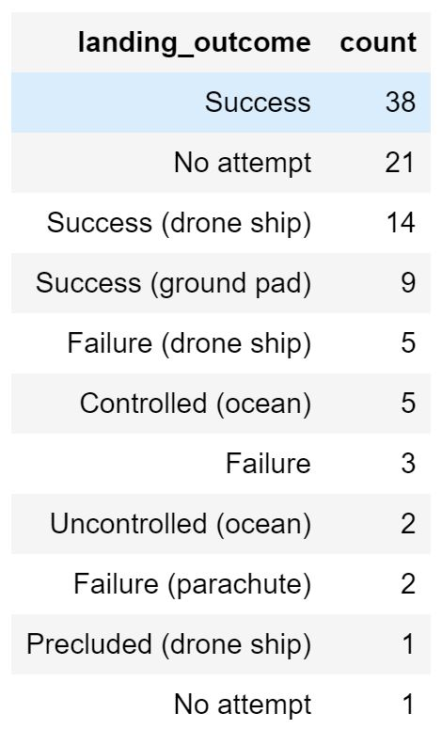
Launch Records
Failed landings in 2015
Number of occurrences for each type of landing outcome
Notes:
List the failed landing_outcomes in drone ship, their booster versions, and launch site names for in year 2015
Present your query result with a short explanation here
Rank the count of landing outcomes (such as Failure (drone ship) or Success (ground pad)) between the date 2010-06-04 and 2017-03-20, in descending order
Present your query result with a short explanation here

Slide 35
Outline
Executive Summary
Introduction
Methodology
Results
Conclusion
Appendix
Exploratory data analysis (EDA)
Interactive visual analytics
Predictive analysis

Slide 36
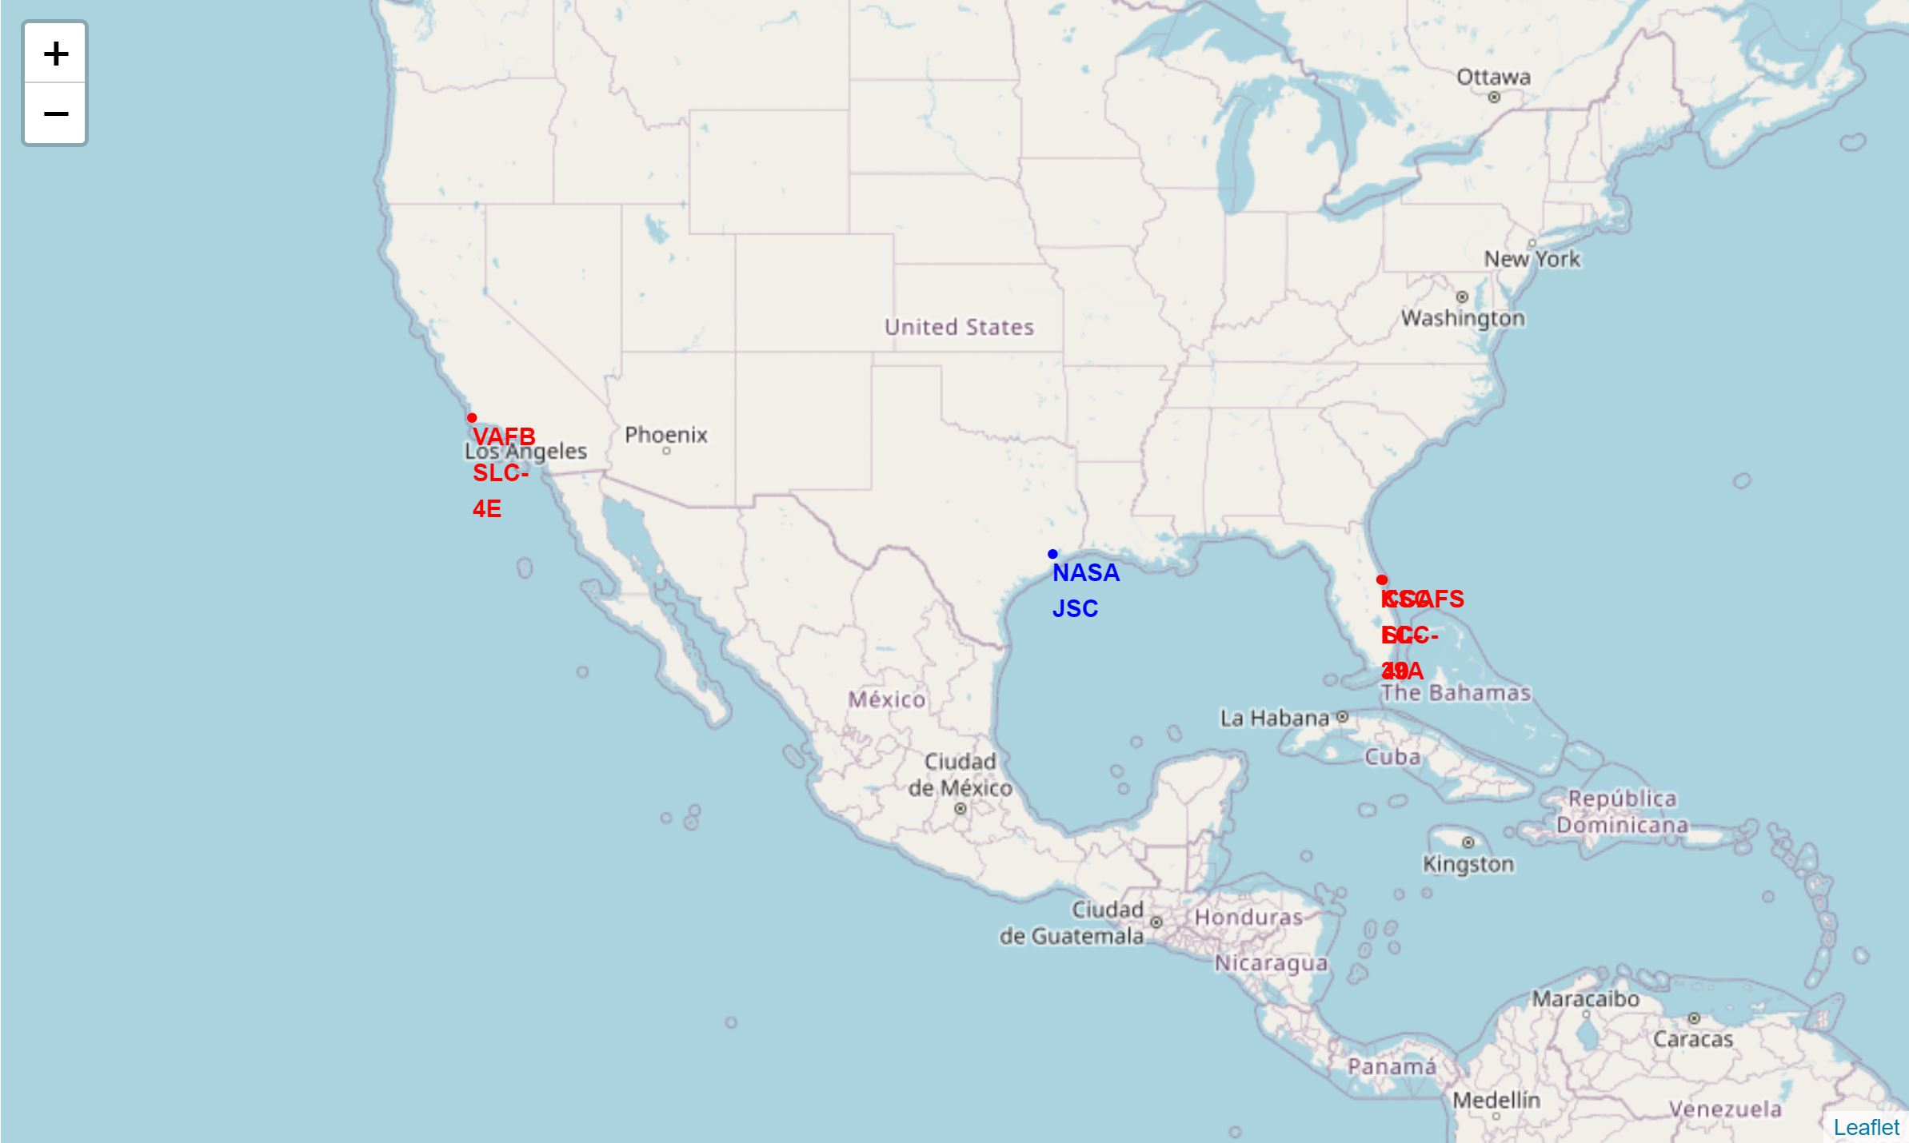
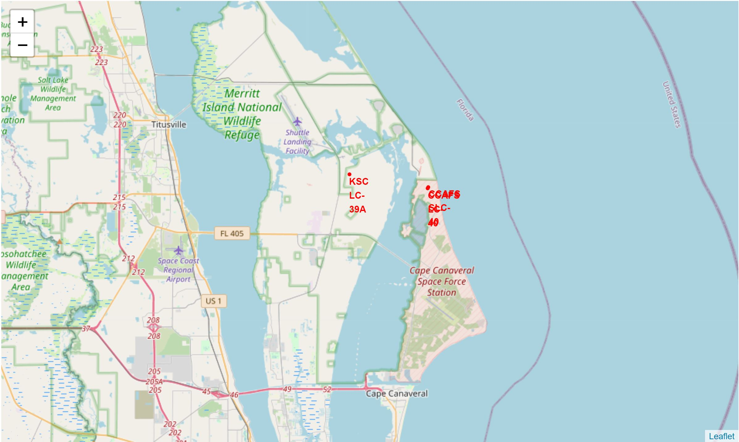
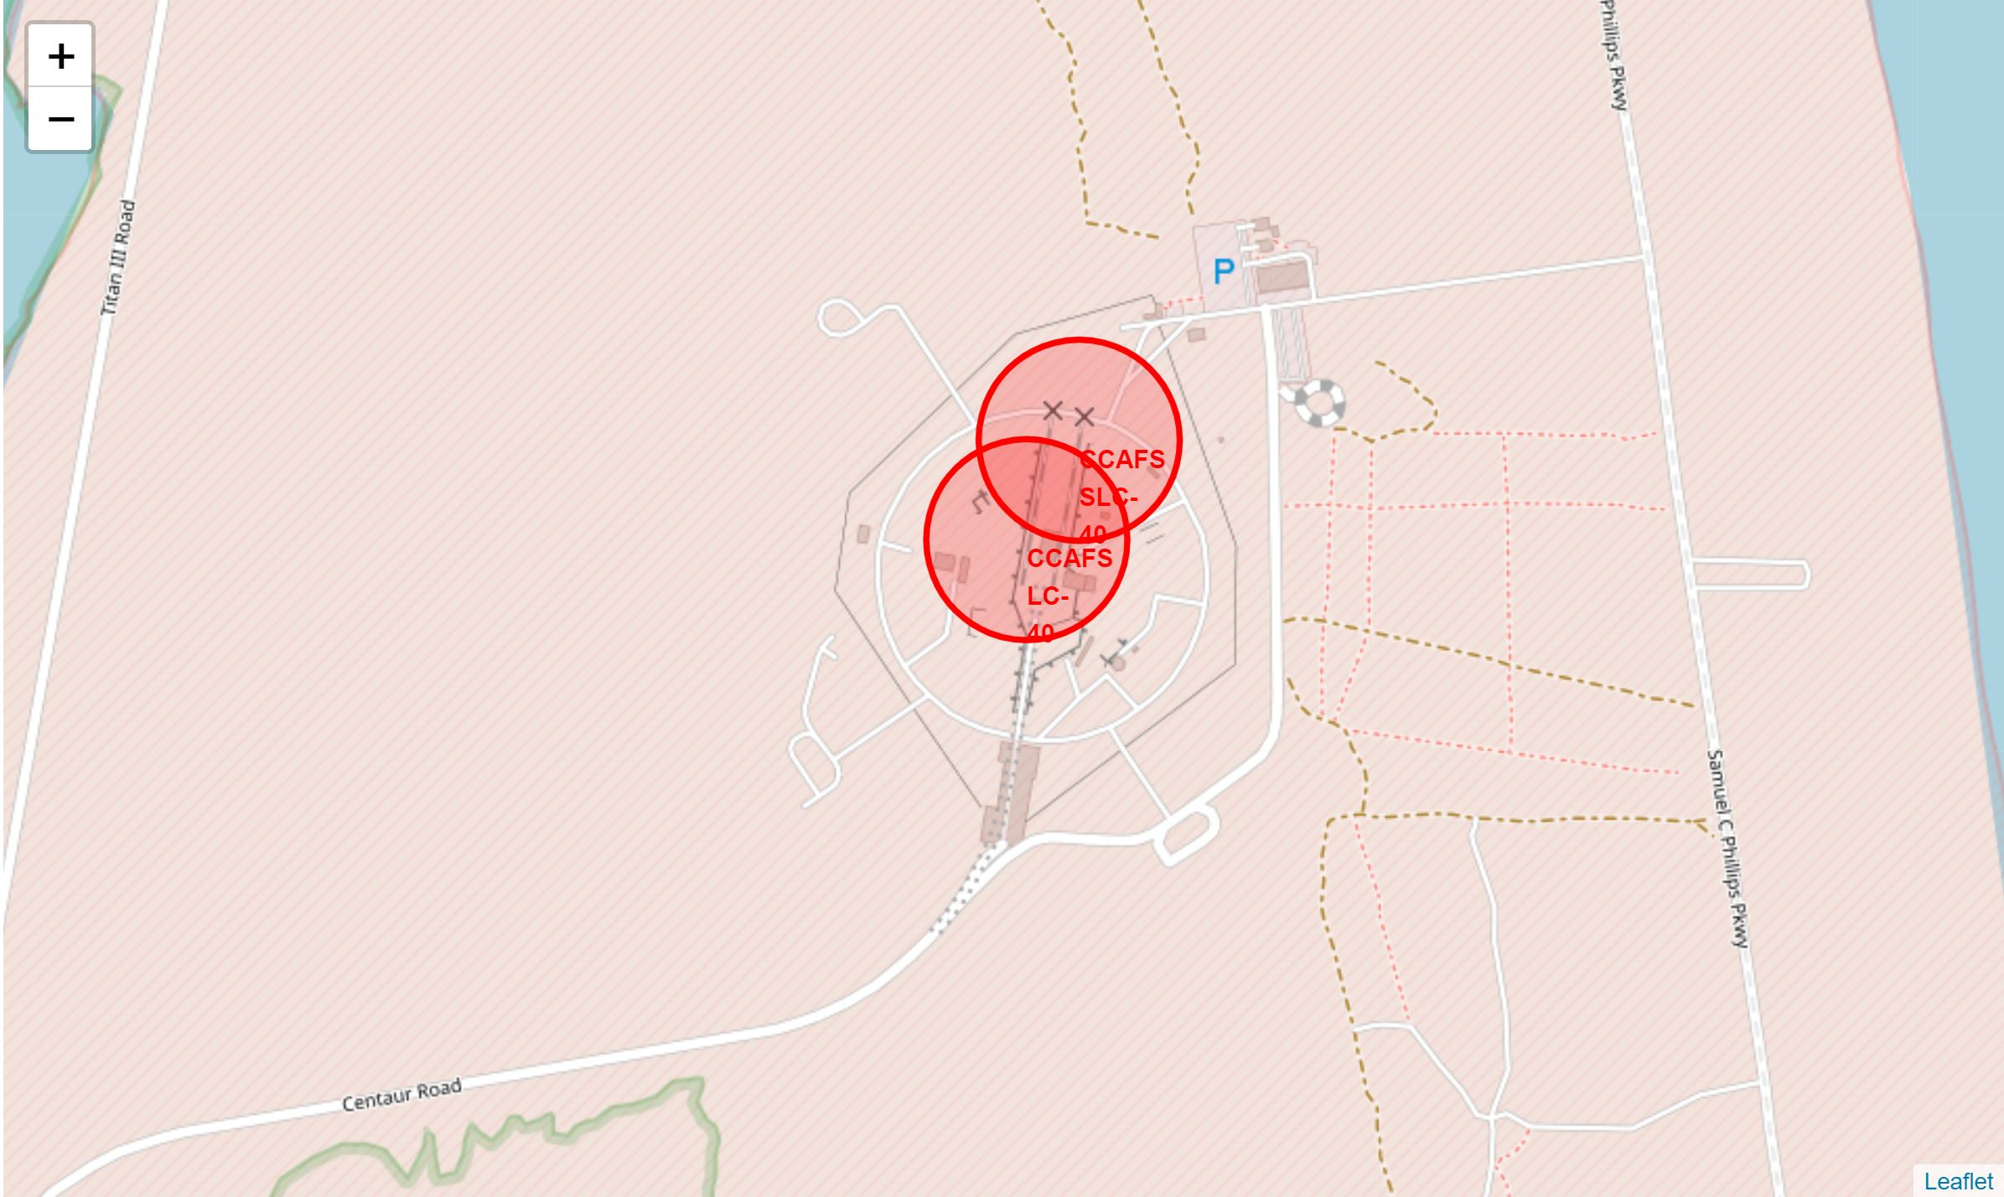
Map of Launch Site Locations
Close proximity to the coast
Large uninhabited area
Mainly eastern coast
Launches towards east, 'help' due to Earth rotation
Close to equator
More 'help'
Notes:
Replace <Folium map screenshot 1> title with an appropriate title
Explore the generated folium map and make a proper screenshot to include all launch sites’ location markers on a global map
Explain the important elements and findings on the screenshot

Slide 37
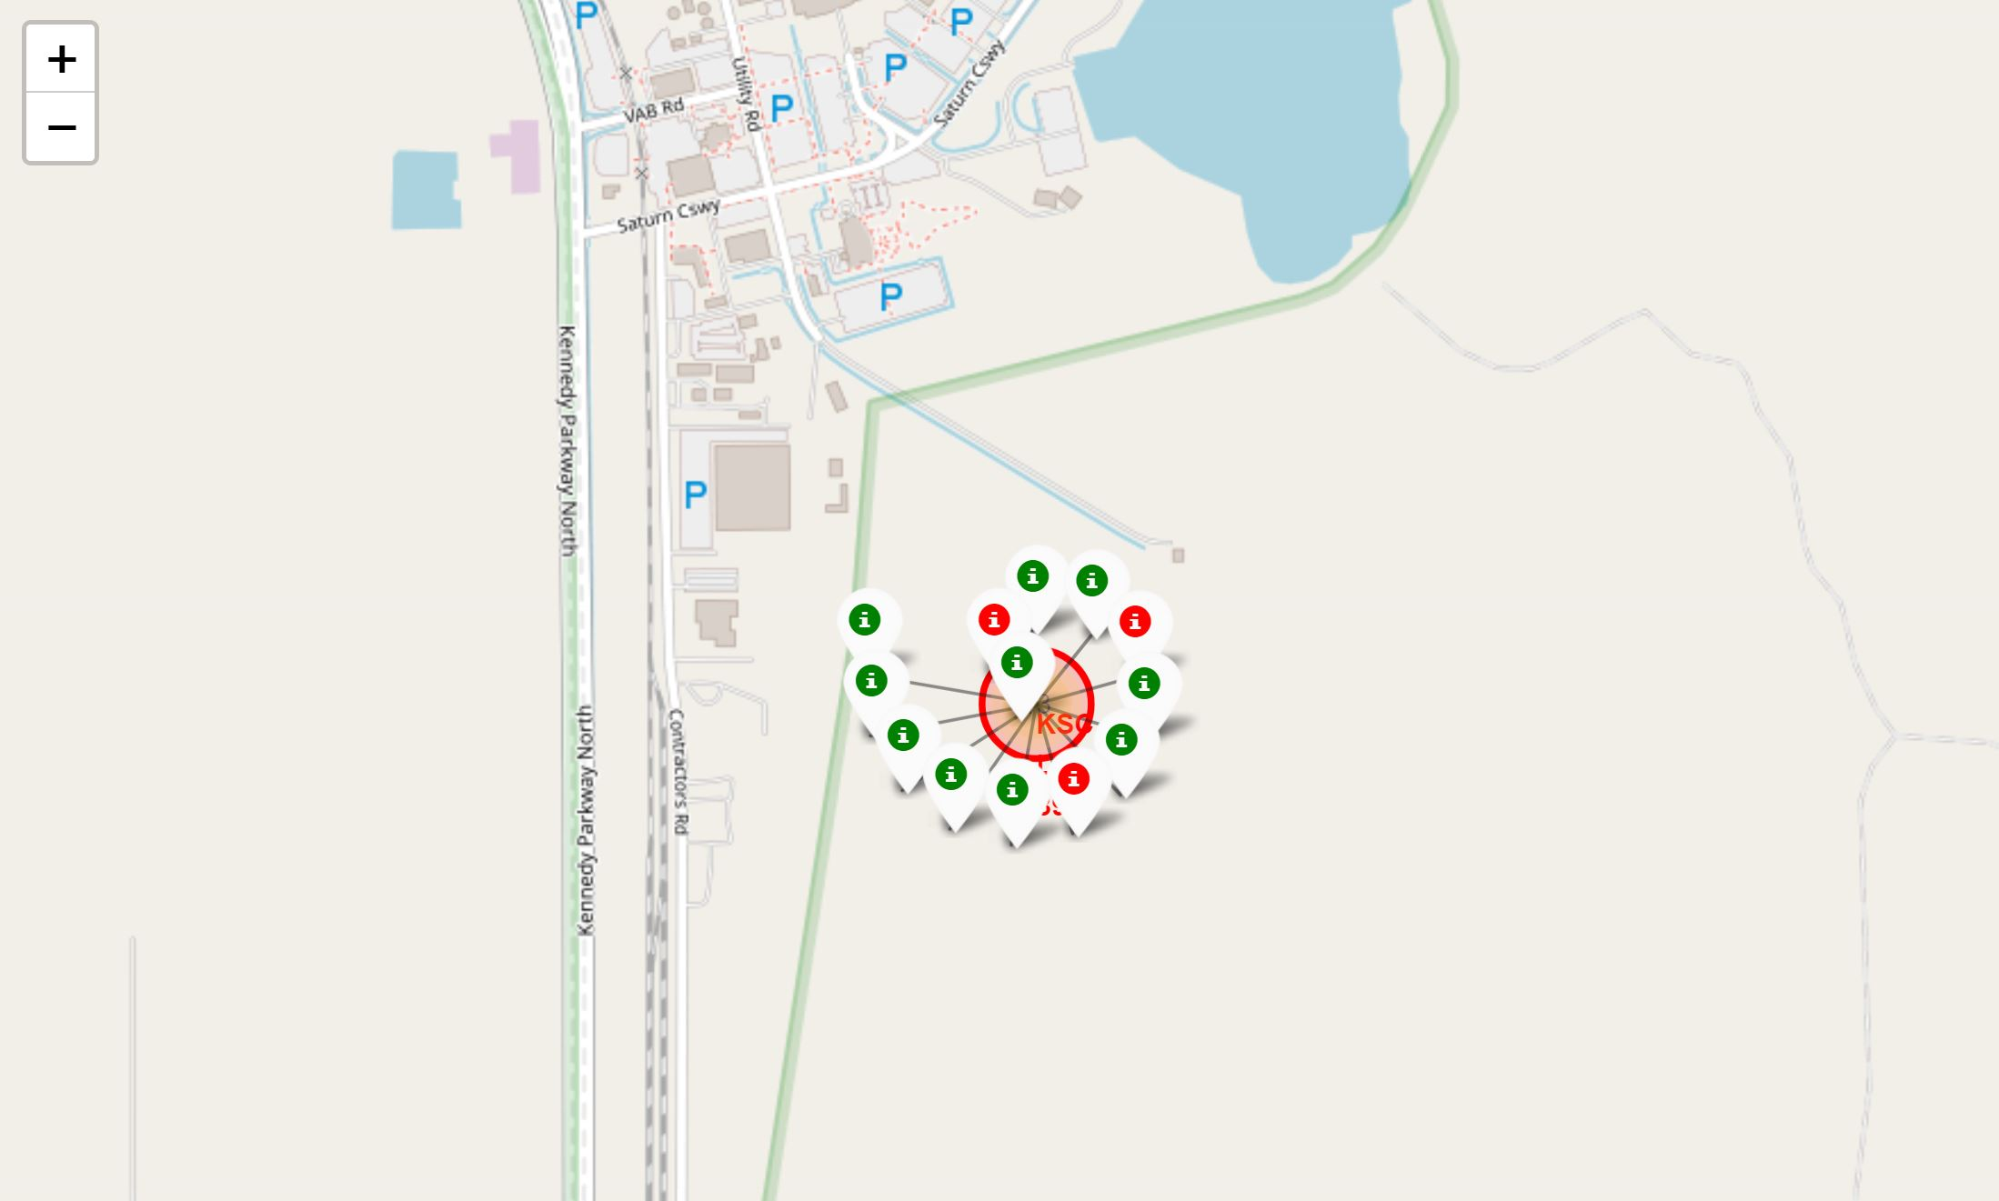
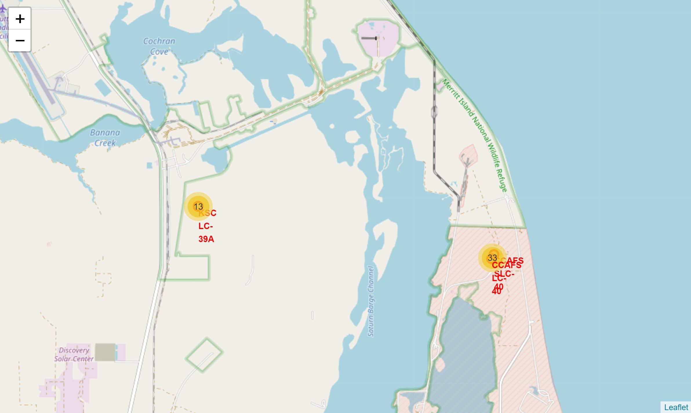
Launches per Launch Site
i
Failed landing
Successful landing
i
Notes:
Replace <Folium map screenshot 2> title with an appropriate title
Explore the folium map and make a proper screenshot to show the color-labeled launch outcomes on the map
Explain the important elements and findings on the screenshot

Slide 38
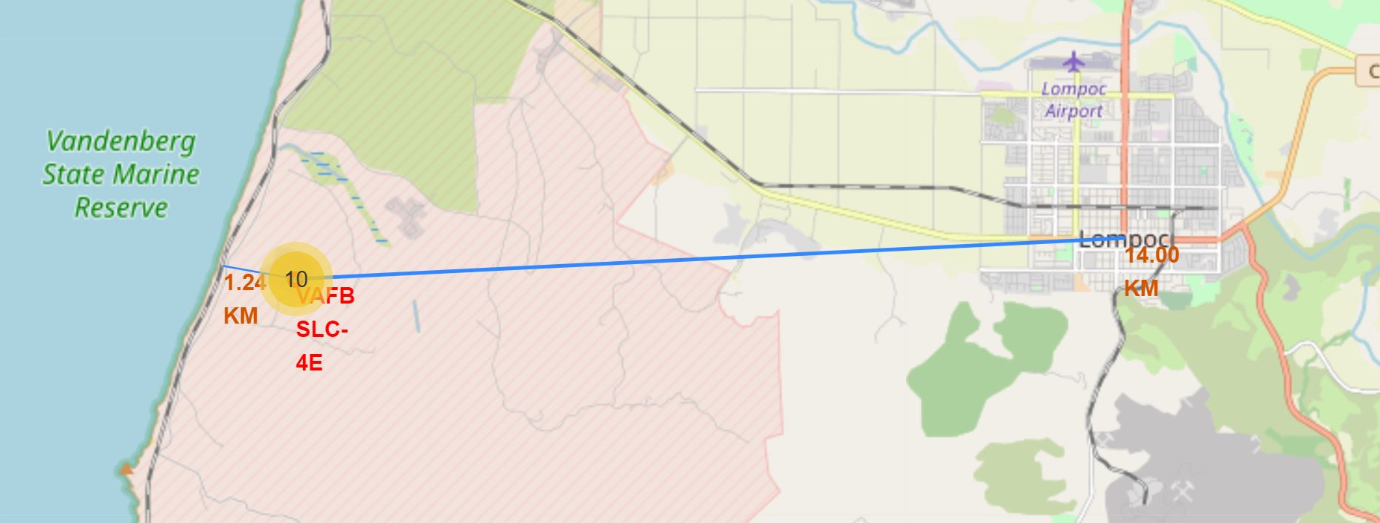
Launch Sites proximity to infrastructure
close proximity to highways and railways
Bring people and material
Close proximity to coastline
Ocean safe for falling parts
Safe distance from settlements
Avoid damage due to failures
Notes:
Replace <Folium map screenshot 3> title with an appropriate title
Explore the generated folium map and show the screenshot of a selected launch site to its proximities such as railway, highway, coastline, with distance calculated and displayed
Explain the important elements and findings on the screenshot

Slide 39
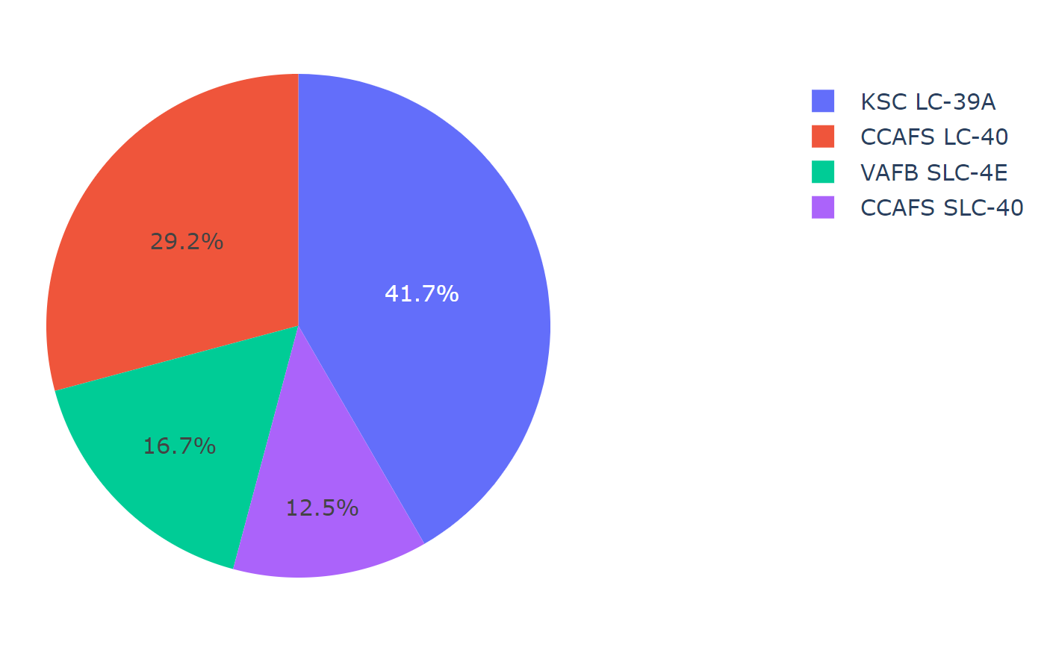
Percentage of total successful landings
The launch site KSC LC-39A has the most successful landings (41.7% of the overall successful landings)
The fewest successful landings are recorded at launch site CCAFS SLC-40 (12.5%)
These numbers are absolute and not weighed against the total number of landings attempted at each site!
Notes:
Replace <Dashboard screenshot 1> title with an appropriate title
Show the screenshot of launch success count for all sites, in a piechart
Explain the important elements and findings on the screenshot

Slide 40
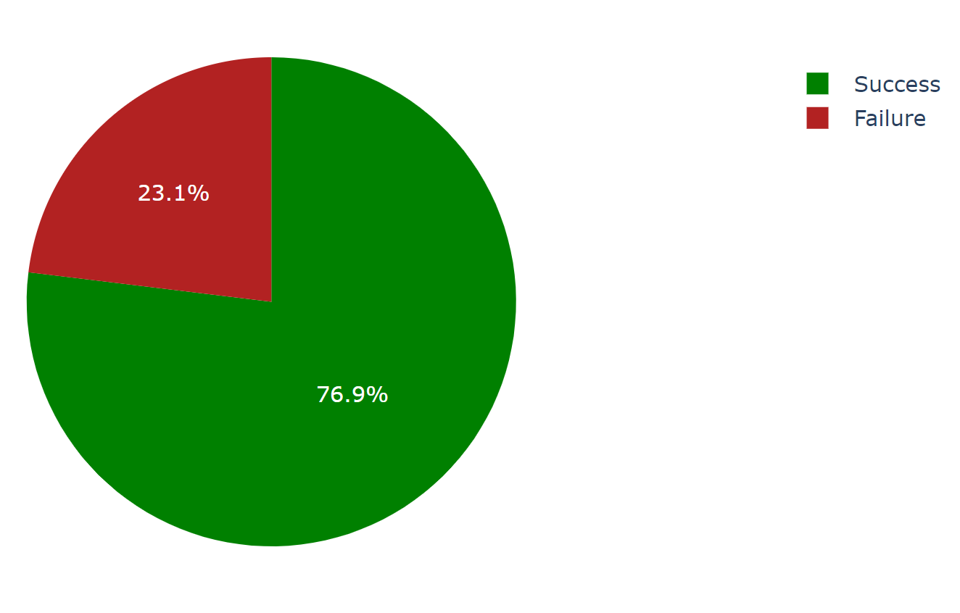
Landing outcome at launch site KSC LC-39A
KSC LC-39A has also the highest landing success rate
Of all the attempted landings at this site 76.9% were successful
While only 23.1% failed
Notes:
Replace <Dashboard screenshot 2> title with an appropriate title
Show the screenshot of the piechart for the launch site with highest launch success ratio
Explain the important elements and findings on the screenshot

Slide 41
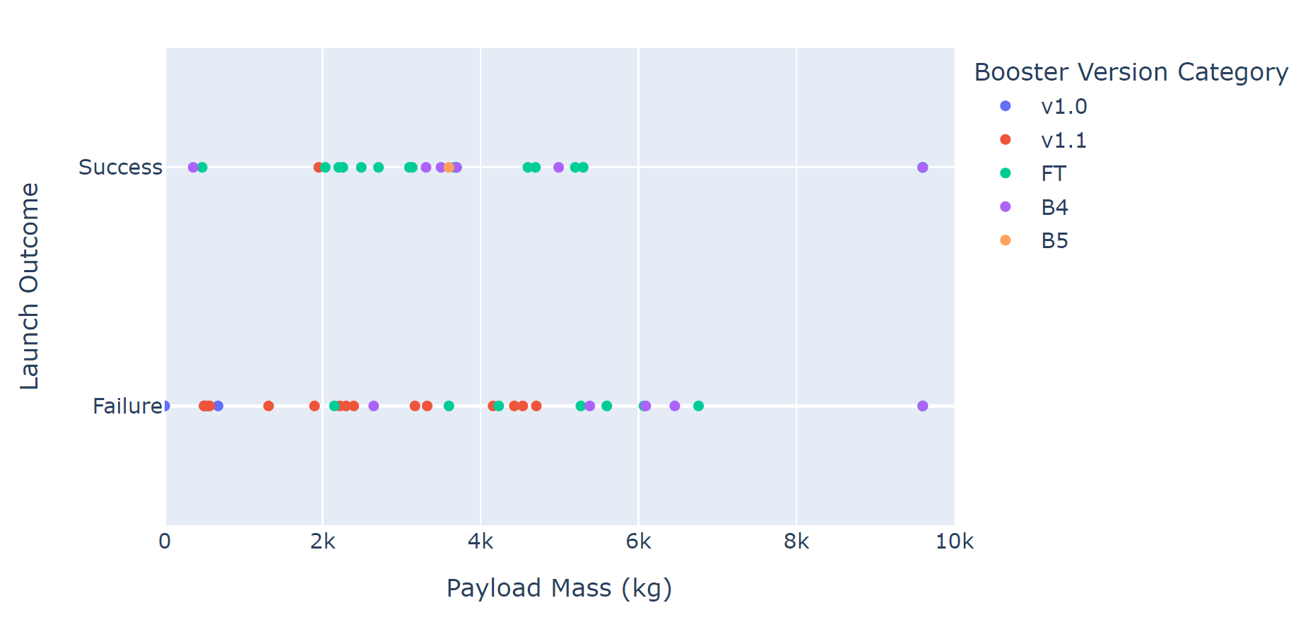
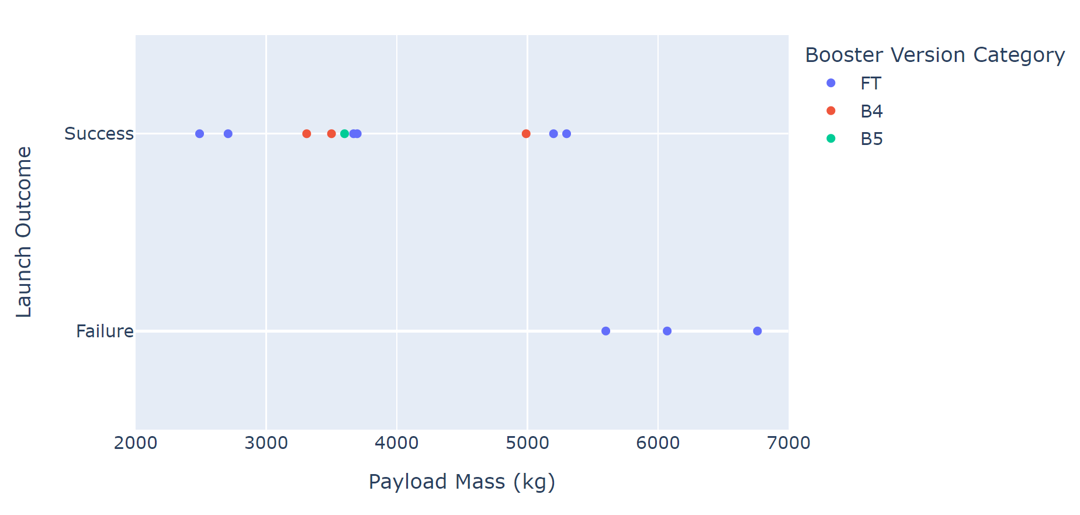
Lunch Outcome vs Payload
For all launch sites:
A high percentage of the v1.1 Booster Version resulted in failed landings, independently of payload
For KSC LC-39A:
Launches with payload smaller than 5500kg resulted in successful landings
While heavier launches failed to land successfuly
Notes:
Replace <Dashboard screenshot 3> title with an appropriate title
Show screenshots of Payload vs. Launch Outcome scatter plot for all sites, with different payload selected in the range slider
Explain the important elements and findings on the screenshot, such as which payload range or booster version have the largest success rate, etc.

Slide 42
Outline
Executive Summary
Introduction
Methodology
Results
Conclusion
Appendix
Exploratory data analysis (EDA)
Interactive visual analytics
Predictive analysis

Slide 43
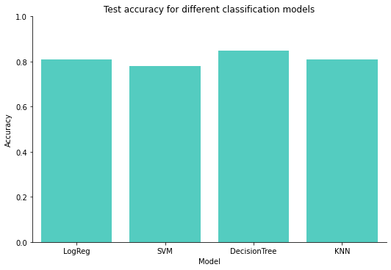
Classification Accuracy
All classification models have a prediction accuracy of around 0.8+- 0.5
The highest accuracy has the Decision Tree model (although it also has the highest variance in accuracy – not seen here)
Notes:
Visualize the built model accuracy for all built classification models, in a bar chart
Find which model has the highest classification accuracy

Slide 44
Confusion Matrix – Decision Tree
For a selected range of launches the model predicts 9 failed landings and 18 successful ones
Almost all failure predictions (8 out of 9) were indeed failed landings
And only 3 of the success predictions actually resulted in failures
Total model accuracy: 0.85
Notes:
Show the confusion matrix of the best performing model with an explanation

Slide 45
Outline
Executive Summary
Introduction
Methodology
Results
Conclusion
Appendix

Slide 46
Conclusions
Most promising orbit is VLEO with 14 launches and about 85% success rate
Non-monotonous increase in success rate between the years of 2013 to 2020
Launch Sites: mainly eastern coast; close proximity to transport infrastructure; far from settlements; KSC LC-39A has the most successful landings
A high percentage of the v1.1 Booster Version resulted in failed landings, independently of payload
All classification models have a prediction accuracy of around 0.8+- 0.5

Slide 47
Outline
Executive Summary
Introduction
Methodology
Results
Conclusion
Appendix

Slide 48
Appendix
Include any relevant assets like Python code snippets, SQL queries, charts, Notebook outputs, or data sets that you may have created during this project
Yeah – no! Way too many, people would just get confused...

Slide 49


